Slide 1
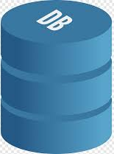
Database
A database is a data structure that stores organized information. Most databases contain multiple tables, which may each include several different fields. For example, a company database may include tables for products, employees, and financial records.

Slide 2
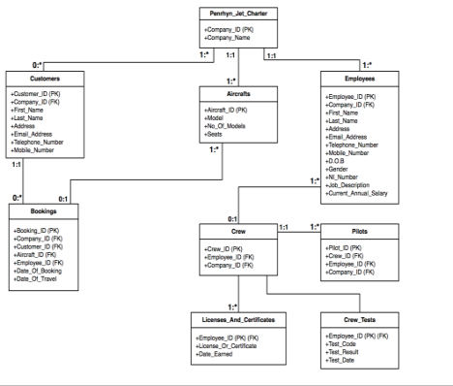
What is a Relational Database?
A relational database is a type of database. It uses a structure that allows us to identify and access data in relation to another piece of data in the database. Often, data in a relational database is organized into tables.

Slide 3
What is a Relational Database Management System (RDBMS)?
A relational database management system (RDBMS) is a program that allows you to create, update, and administer a relational database. Most relational database management systems use the SQL language to access the database.

Slide 4
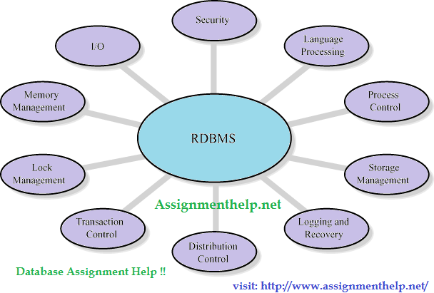

Slide 5
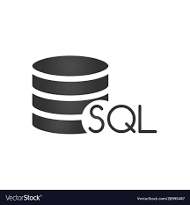
What is SQL?
SQL (Structured Query Language) is a programming language used to communicate with data stored in a relational database management system. Many RDBMSs use SQL (and variations of SQL) to access the data in tables. For example, SQLite is a relational database management system. SQLite contains a minimal set of SQL commands (which are the same across all RDBMSs). Other RDBMSs may use other variants.

Slide 6
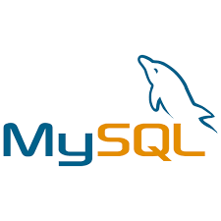
What is MySQL
MySQL is MySQL, the most popular Open Source SQL database management system, is developed, distributed, and supported by Oracle Corporation.
It may be anything from a simple shopping list to a picture gallery or the vast amounts of information in a corporate network. To add, access, and process data stored in a computer database, you need a database management system such as MySQL Server.

Slide 7
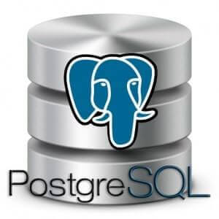
What is PostgreSQL?
PostgreSQL is a powerful, open source object-relational database system that uses and extends the SQL language combined with many features that safely store and scale the most complicated data workloads. The origins of PostgreSQL date back to 1986 as part of the POSTRES project at the University of California at Berkeley and has more than 30 years of active development on the core platform.

Slide 8
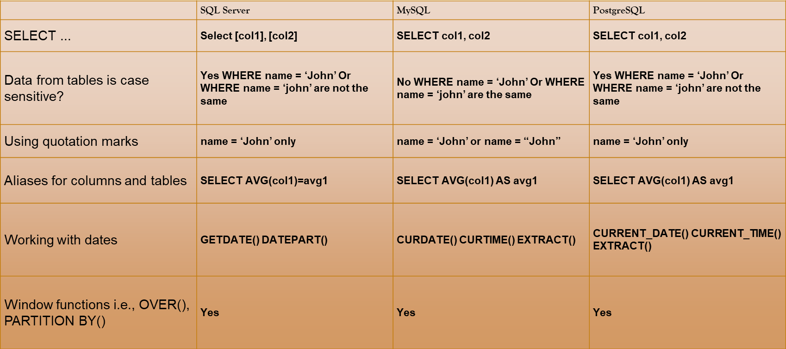
Comparison Between The Three RDBMS

